Slide 1
Types of learning problems
1. Supervised
a. Classification
b. Regression
2. Unsupervised
a. Clustering
b. Association
3. Reinforcement

Slide 2
Types of learning problems
1. Supervised
a. Classification
b. Regression
2. Unsupervised
a. Clustering
b. Association
3. Reinforcement

Slide 3
Correlation vs. Regression
A scatter plot can be used to show the relationship between two variables
Correlation analysis is used to measure the strength of the association (linear relationship) between two variables
Correlation is only concerned with strength of the relationship
No causal effect is implied with correlation
Scatter plots
Correlation

Slide 4
12.1 Regression Models
Linear relationships
Curvilinear relationships
Y
Y
X
X
Y
Y
X
X

Slide 5
Types of Relationships
Strong relationships
Weak relationships
Y
Y
X
X
Y
Y
X
X

Slide 6
Types of Relationships
No relationship
Y
X
Y
X

Slide 7
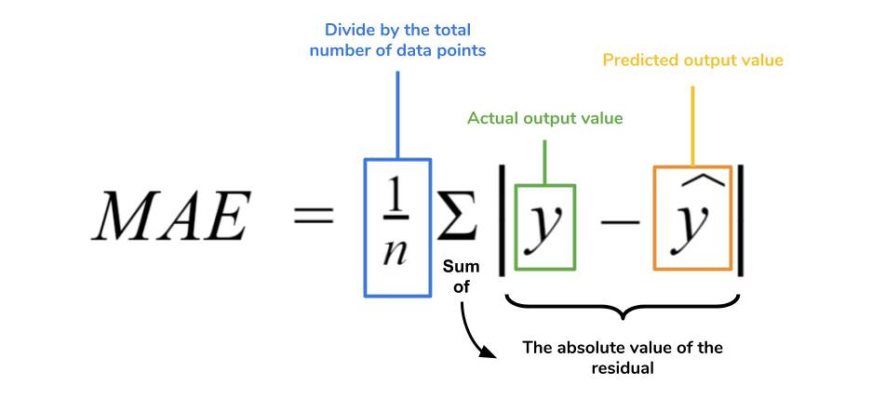
Metrics

Slide 8
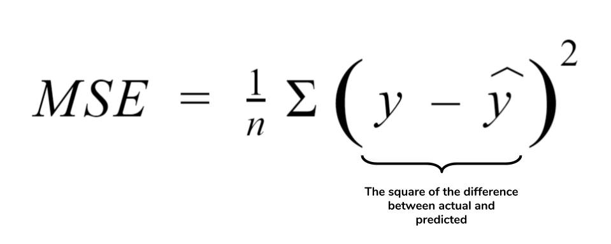
Metrics

Slide 9

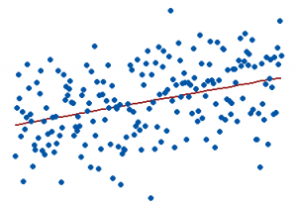
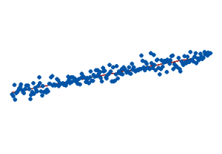
Metrics
0% represents a model that does not explain any of the variation in the response variable around its mean. The mean of the dependent variable predicts the dependent variable as well as the regression model.
100% represents a model that explains all the variation in the response variable around its mean.

Slide 10

Cross-validation
Notes:
PC: https://en.wikipedia.org/wiki/Cross-validation_(statistics)

Slide 11
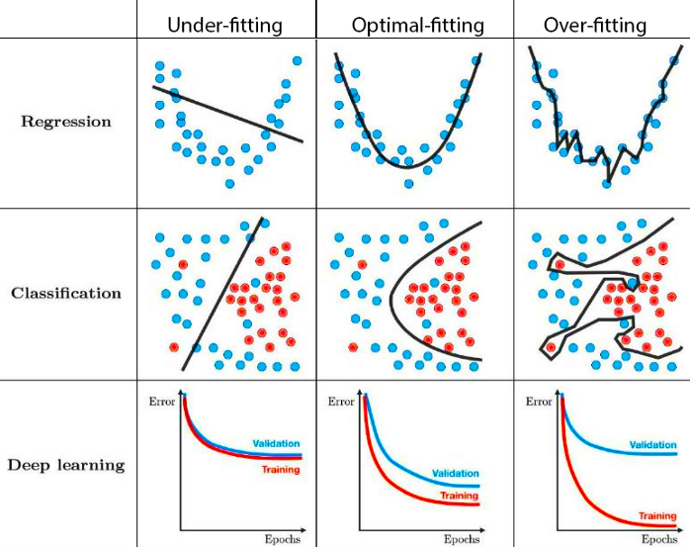
Challenges: Underfitting & Overfitting
Notes:
PC: https://towardsdatascience.com/techniques-for-handling-underfitting-and-overfitting-in-machine-learning-348daa2380b9

Slide 12
Correlation vs. Regression
A scatter plot can be used to show the relationship between two variables
Correlation analysis is used to measure the strength of the association (linear relationship) between two variables
Correlation is only concerned with strength of the relationship
No causal effect is implied with correlation
Scatter plots
Correlation

Slide 13
12.1 Regression Models
Linear relationships
Curvilinear relationships
Y
Y
X
X
Y
Y
X
X

Slide 14
Types of Relationships
Strong relationships
Weak relationships
Y
Y
X
X
Y
Y
X
X

Slide 15
Types of Relationships
No relationship
Y
X
Y
X

Slide 16
Metrics

Slide 17
Metrics

Slide 18
Metrics
0% represents a model that does not explain any of the variation in the response variable around its mean. The mean of the dependent variable predicts the dependent variable as well as the regression model.
100% represents a model that explains all the variation in the response variable around its mean.

Slide 19
Cross-validation
Notes:
PC: https://en.wikipedia.org/wiki/Cross-validation_(statistics)

Slide 20
Challenges: Underfitting & Overfitting
Notes:
PC: https://towardsdatascience.com/techniques-for-handling-underfitting-and-overfitting-in-machine-learning-348daa2380b9

